Slide 1


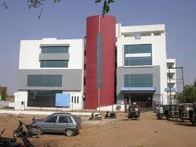
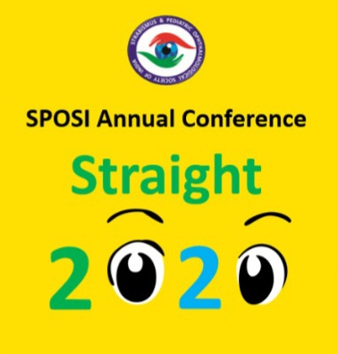
ARE BINOCULAR AND MONOCULAR SCREENING DEVICES (PLUSOPTIX) AS EFFECTIVE AS STANDARD AUTOREFRECTOMETER?
There is no financial interest of any of the authors behind conducting this study and no financial assistance was provided by any institution or organization and there are no competing interests, conducted after approval of ethical committee
PRESENTING AUTHOR-
Dr Sakshi Makhloga
CO AUTHORS-
Dr Shreya Shah
Dr Mehul Shah
Dr Pradeep Chandane

Slide 2

Aim:
TO COMPARE PLUSOPTIX WITH STANDARD AUTOREFRECTOR FOR EFICACY

Slide 3

Method
STUDY WAS CONDUCTED AFTER OBTAINING CONSENT FROM HOSPITAL REVIEW BOARD.
THIS WAS A PROSPECTIVE STUDY.
WE ENROLLED PATIENTS SUBJECTED TO REFRACTION BY PLUS OPTIX (NO FINANCIAL INTEREST) FOLLOWED BY REFRACTION BY STANDARD AUTOREFRACTOR (TOPCON RM 800, NO FINANCIAL INTEREST)

Slide 4
DATA COLLECTION DONE IN ONLINE FORMAT WHICH WAS EXPORTED IN EXCEL SHEET.
DATA WAS ANALYSED WITH SPSS-22 UNIVARIATE AND MULTI VARIATE ANALYSIS DONE.
COMPARATIVE STUDY DONE WITH CROSS TABULATION AND STUDENT T TEST.
P<0.05 CONSIDERED STASTICALLY SIGNIFICANT.

Slide 5

OBSERVATION TABLE
SAMPLE SIZE | 75 CHILDREN
MALES | 42
FEMALES | 33
MEAN AGE | 9.5 YEARS
p VALUE (PLUSOPTIX) | 0.115
p VALUE (AUTOREFRACTORS) | 0.152

Slide 6

Result
WE ENROLLED 75 CHILDREN OUT OF THESE 42 MALE 33 FEMALE WITH MEAN AGE 9.5YRS.
ON COMPARATIVE STUDY WE COULD NOT DETECT SIGNIFICANT DIFFERENCE IN SPHERICAL VALUES AND CYLINDRICAL READINGS MEASURED BY PLUS OPTIX AND AUTO REFRACTORS (P= 0.115,p=0.152)

Slide 7

Conclusion
PLUS OPTIX IS RELIABLE METHOD OF OBJECTIVE REFRACTION AND SCREENING

Slide 8

THANK YOU

